Slide 1


THE implementation of circular economy concept in the curricula
UNIVERSITY OF DEBRECEN
VUA GENERAL MEETING
Sept 3, 2018
Csaba Fogarassy PhD
INVITED LECTURER
Szent Istvan University
Climate Change Economics Research Centre

Slide 2


IntrodUction - OPPORTUNITY TO TRANSFORM
The transition to a more sustainable or circular economy, where the value of products, materials and resources is maintained in the economy for as long as possible, and the generation of waste minimised, is an essential contribution to the EU's efforts to develop a sustainable, low carbon, resource efficient and COMPETITIVE economy.
The circular economy will BOOST the EU's competitiveness by protecting businesses against scarcity of resources and volatile prices, helping to create NEW BUSINESS opportunities and innovative, more efficient ways of producing and consuming.
EUR 1 billion from Horizon 2020 = CE

Slide 3
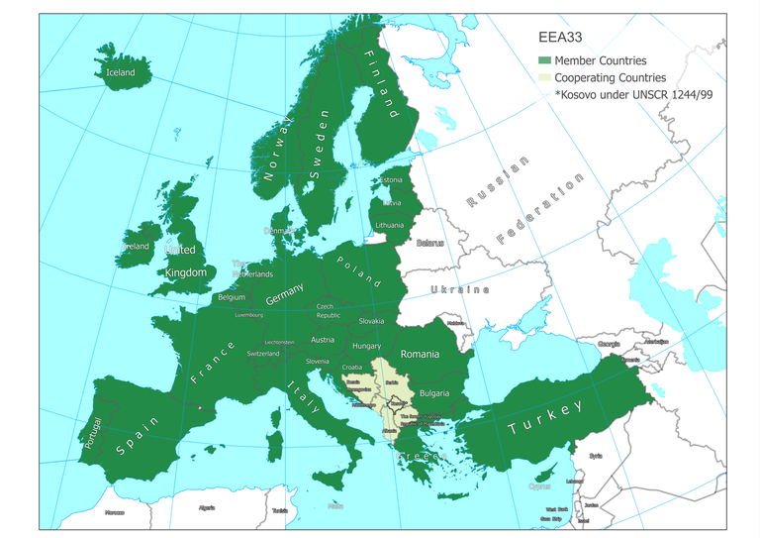
ACTIONS AT EU LEVEL
The action plan focusses on action at EU level with high added value. Making the circular economy a reality will however require long-term involvement at all levels, from Member States, regions and cities, to businesses and citizens.
Member States are invited to play their FULL PART IN EU ACTION, integrating and complementing it with national action.
A circular economy starts at the very beginning of a product's life. Both the design phase and PRODUCTION PROCESSES have an impact on sourcing, resource use and waste generation throughout a product's life.
ON The NEXT AREA: consumption, waste management, transportation, contsruction, energy production.

Slide 4
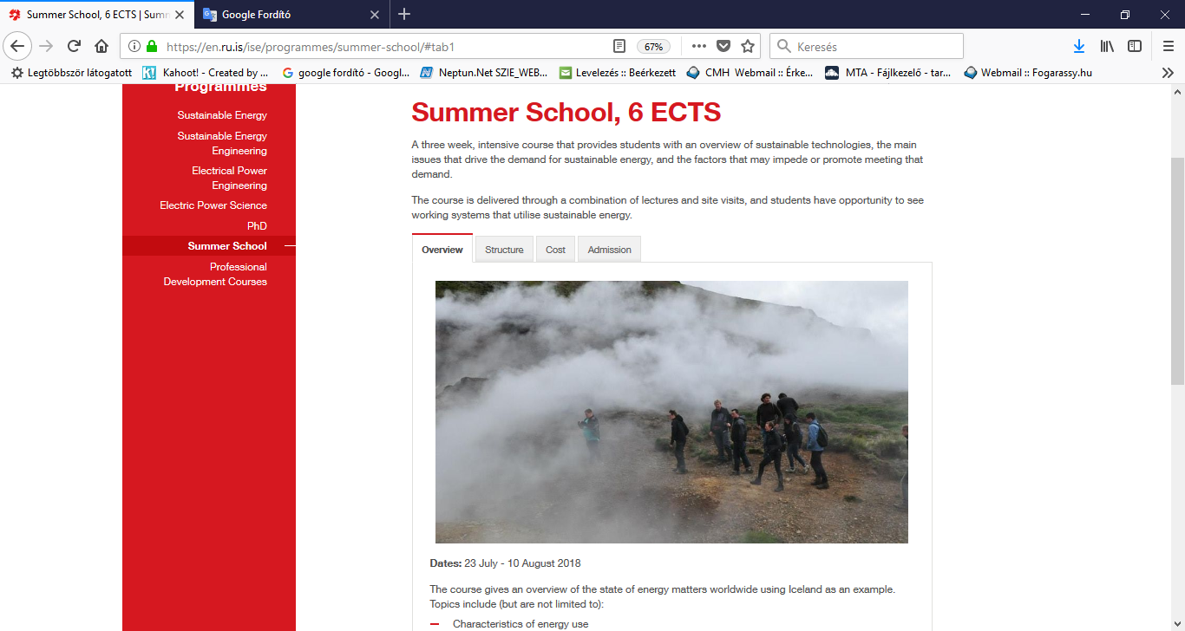
Part of the summer course of SUSTAINABLE ENERGY IN ICELAND 2017/2018
CIRRCULAR ECONY

Slide 5
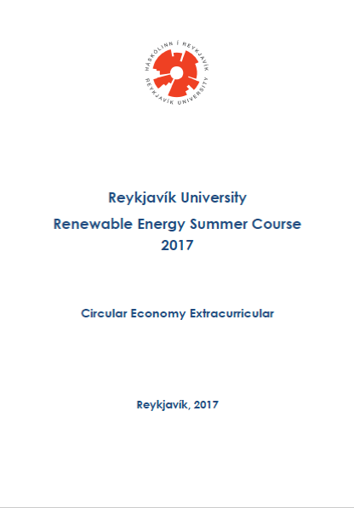
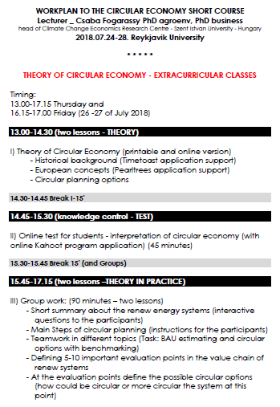
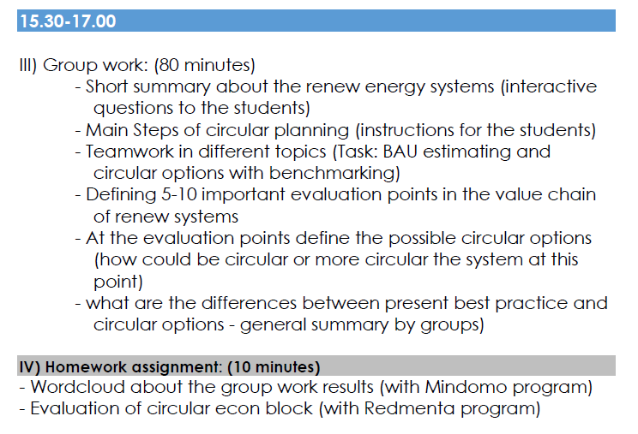
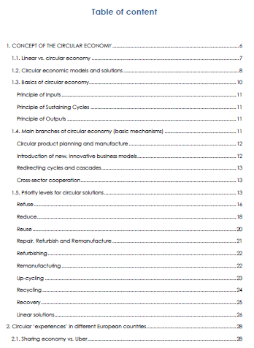
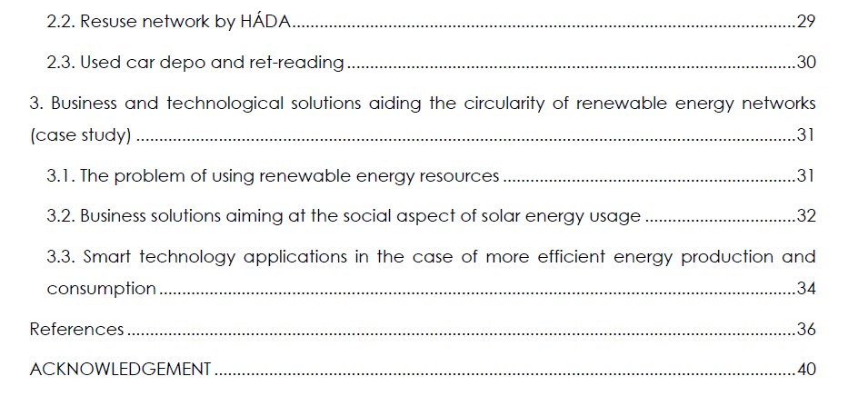
ELEMENTS OF THE CE BUILDING BLOCK

Slide 6
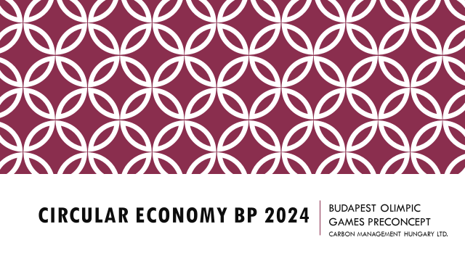
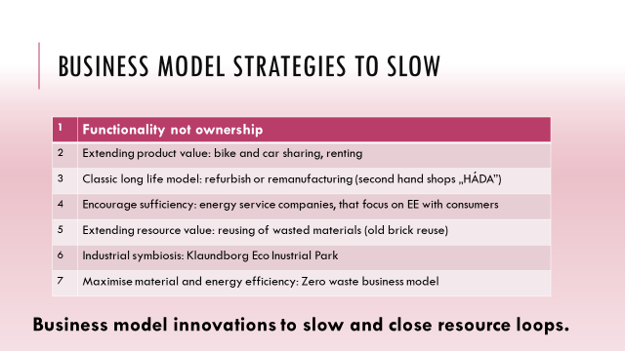
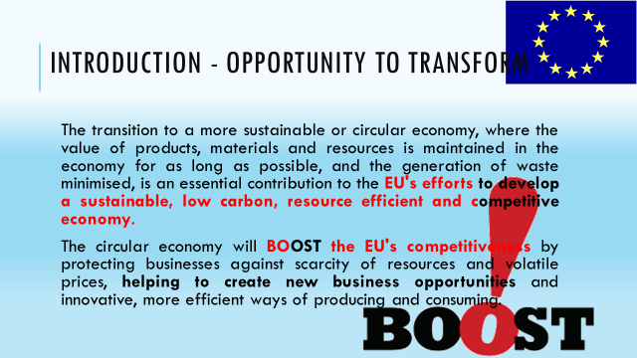
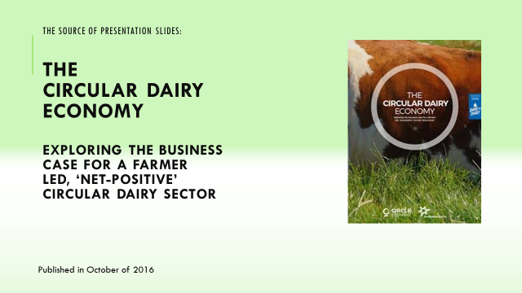
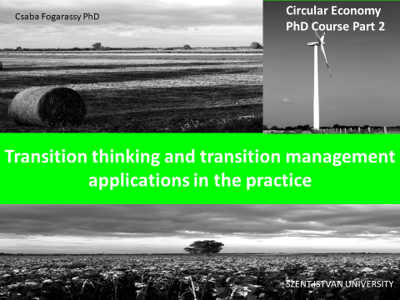
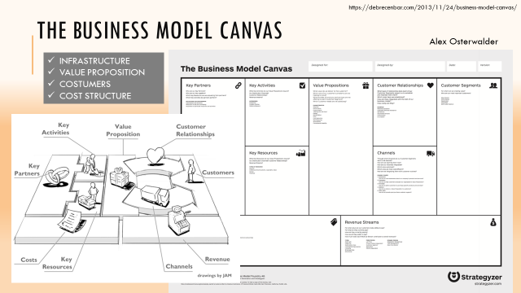
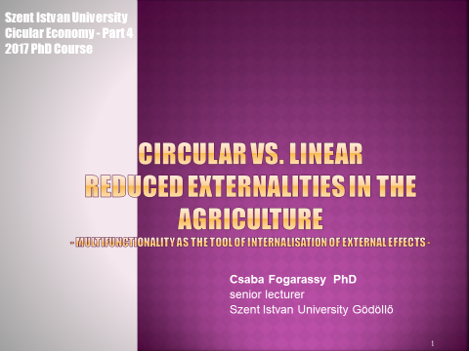
CIRCULAR ECONOMY PHD COURSE from 2016

Slide 7
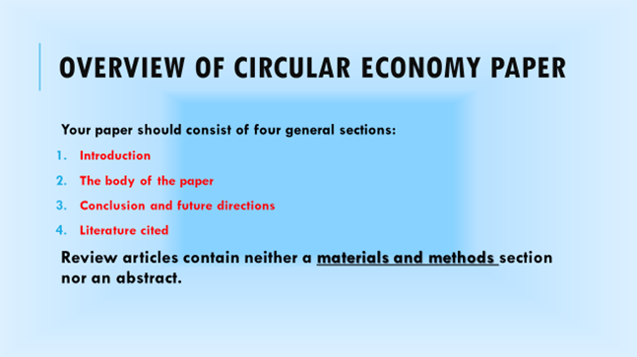
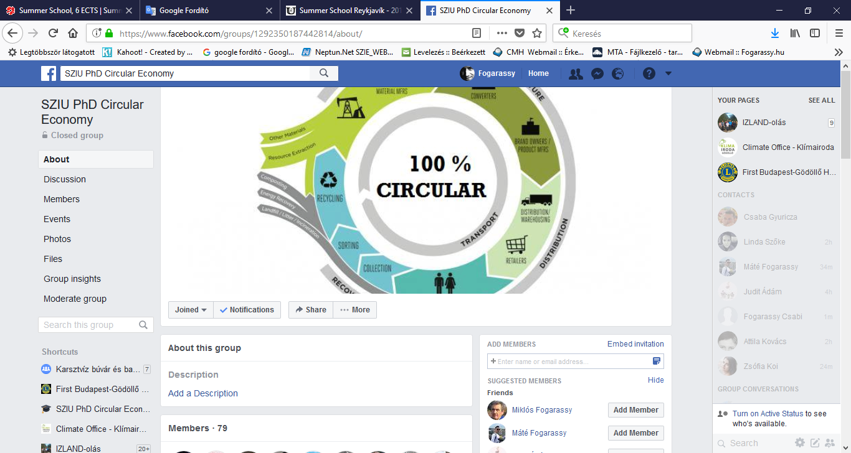

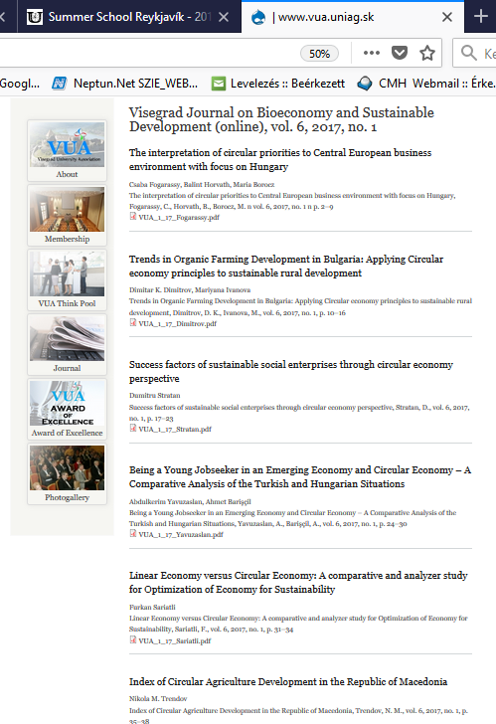
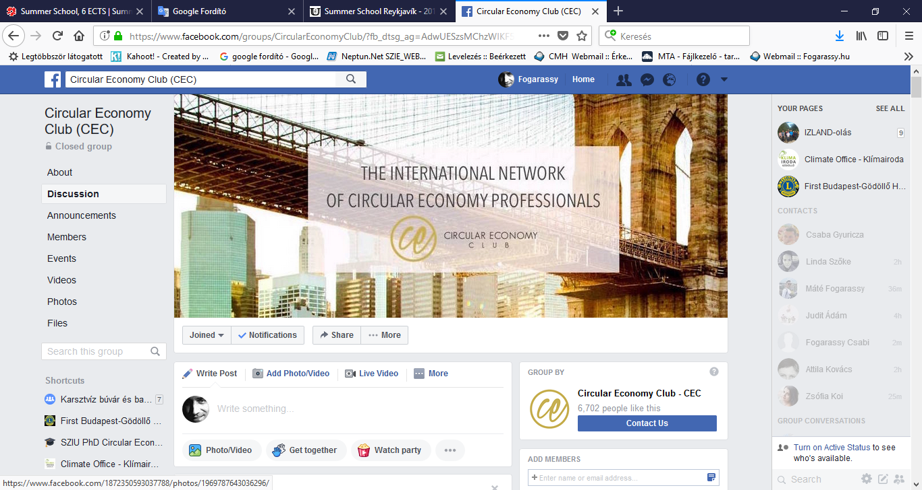
Supporting materials (FACEBOOK, Journals)
Special issue of VUA Journal

Slide 8
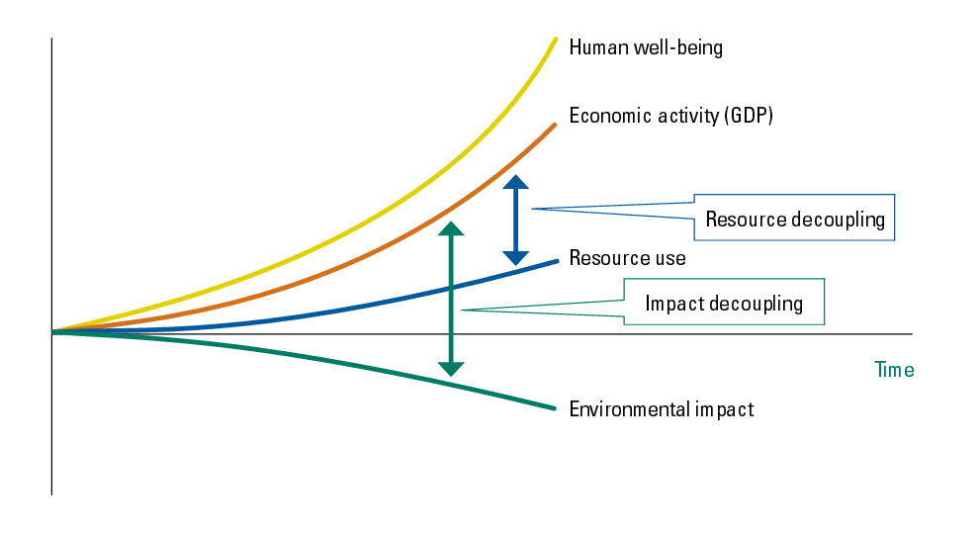
CIRCULAR ECONOMY / Sustainable development
Circular economy is the result of moving from a simple impact reduction model to a model of absolute value creation that is positive, both socially, economically, environmentally…
…..the central element is the “decoupling” of economic growth from an increase in resource use and reduction of environmental impacts.
Kuznets Curve Is Not True!

Slide 9
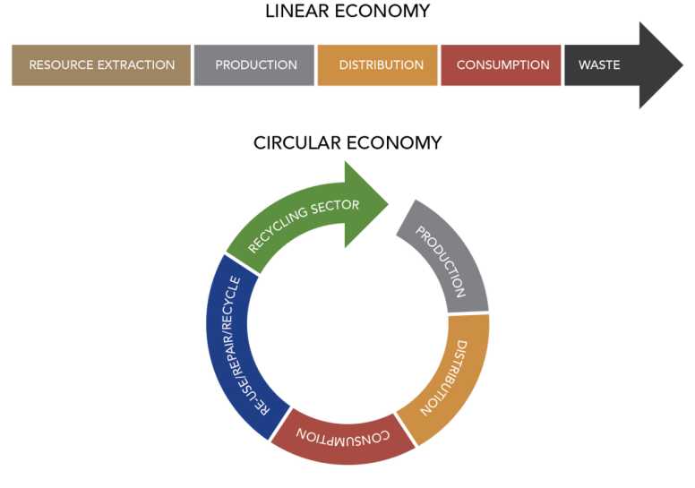
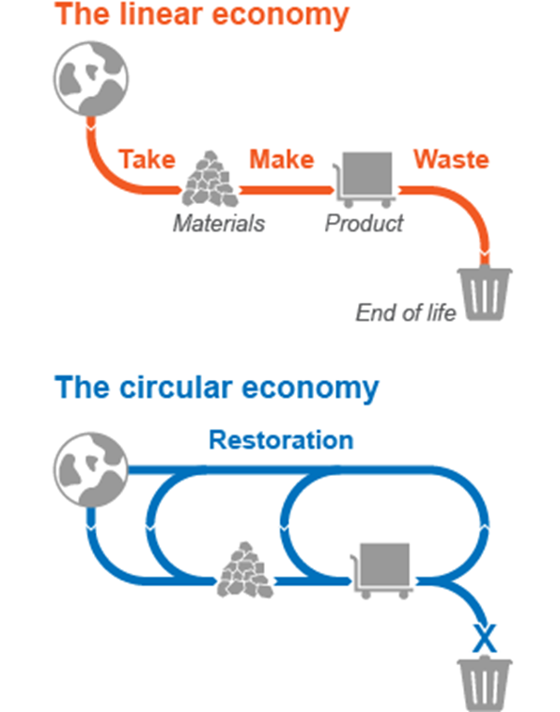
From Linear to circular - OPPORTUNITY TO TRANSFORM
Source: Ellen MacArthur Foundation Team, 2014
The linear economy is based on a linear process, optimised towards high volume of product and low production cost relying on the plentiful availability of raw materials at relatively low cost.
The circular economy aims at low environmental impact by minimising waste and extreme resource use by turning goods at the end of their lifetime. Main ways of circulation are re-use, re-cycle, reductions of waste, re-manifacture and other practices.
Source: Ellen MacArthur Foundation Team, 2014

Slide 10
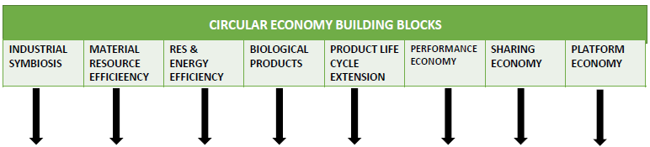
Typical BUILDING BLOCKS of CIRCULAR ECONOMy
Kalunborg
Symbiosis
Car engines and fuels,
to produce more from less input.
Smart buildings
Algies and bacterial for agriculture
Fairphone, repearable phones
B2B software leasing
Car sharing system (Zipcar)
Trading and sercice platforms (eBay, UBER)
http://www.symbiosis.dk/en
The Kalundborg Symbiosis is an industrial ecosystem, where the by-product residual product of one enterprise is used as a resource by another enterprise, in a closed cycle. An industrial symbiosis is a local collaboration where public and private enterprises buy and sell residual products, resulting in mutual economic and environmental benefits.

Slide 11

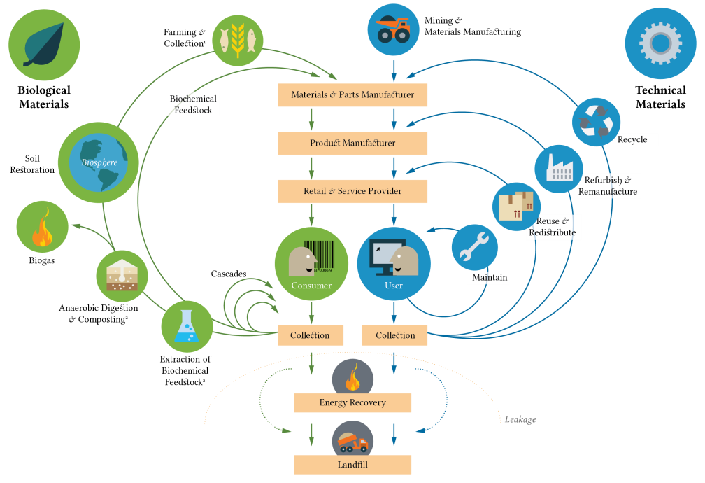
Biological and technical cycles
BIOLOGICAL CYCLES
&
TECHNICAL CYCLES
Source: Ellen MacArthur Foundation, 2014

Slide 12
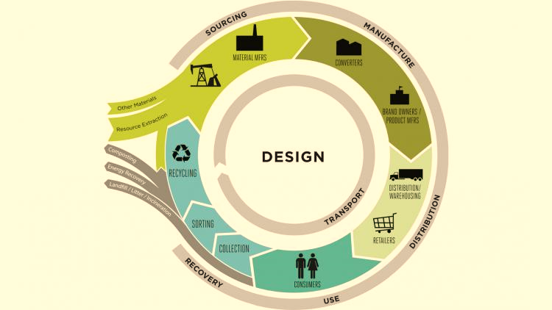
PRINCIPLES OF CIRCULAR ECONOMY
1 - Principle of Inputs
In the case of inputs, the system is basically predestined for sustaining the flow of renewable energy resources, named 'FLOW MANAGEMENT', and during servicing technological processes, it aims to perpetually circulate reserves instead of hoarding them, named 'stock management. They mainly achieve this by sustaining the material flow, most notably via increasing the share of services.
2- Principle of Sustaining Cycles
The previously mentioned biological and technological cycles or cycle processes close system processes via the different-length loops. Circular economic solutions offer development branches in a way that they assure these resources are always at hand through the MATERIAL CYCLES (biological base materials and raw materials), on the highest possible level (f. e. the circulation of soil nutrients, water circulation). The new product cycles of circular economic models are mainly generated within the technological cycles, by reacquisition of resources, or modernisation, repair of technological systems.
3 - Principle of Outputs
The main aim TO AVOID the negative and positive EXTERNALITIES. This includes planned soil usage, avoiding water- and noise pollution, preserving good health, avoiding the usage and generation of toxic materials, avoiding incorrect business solutions, and completing all the procedures listed by using the systems of local resource usage. Preferring local supply systems!

Slide 13
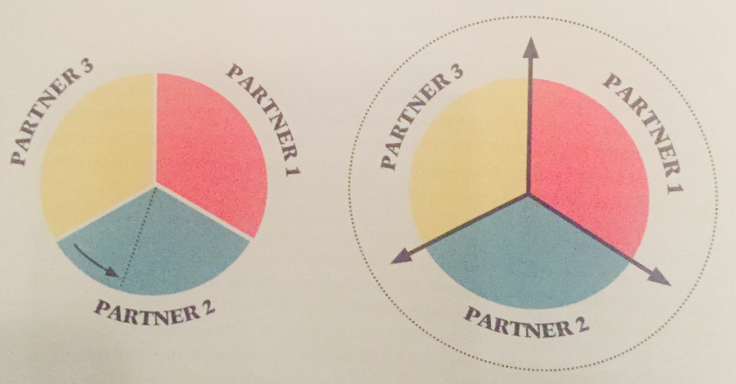
Main branches of circular economy
The goal is not to achieve the biggest slice of the 'pie' possible
The Ellen MacArthur Foundation determined four main points, or basic mechanisms in 2012, which are required for constructing or redesigning the circular economic systems.
These are:
Circular product planning and manufacture
Introduction of new, innovative business models
Redirecting cycles and cascades
Cross-sector cooperation
Bake bigger pies!
The goal is not to achieve the biggest slice of the 'pie' possible

Slide 14
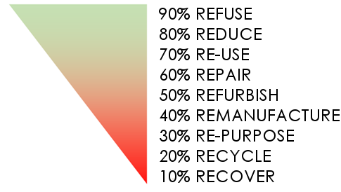
Priority levels of circulation
This is how we can assure that the preferred process is completed with as
low material usage as possible.
The second priority is to minimise the energy used.
1
2

Slide 15

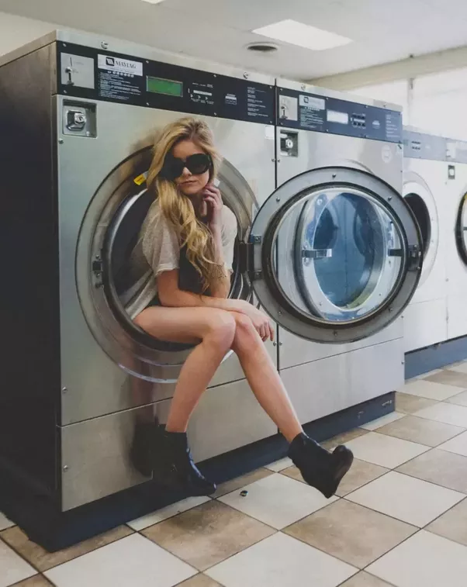
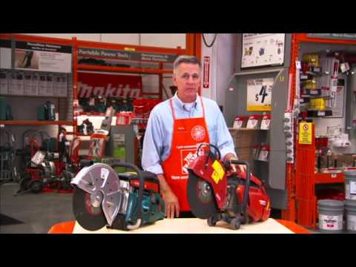
REFUSE
The method above is also one of the most effective interpretations for circularity. In this case, we do not have to produce a new product at all, since consumers REFUSE to purchase said product.
HOW TO USE THE PUBLIC WASHING MASCHINE!
HILTI – HAND-TOOL RENTAL SYSTEM
(No buy! –Rent a drill, a saw, a cutter, a polisher…)

Slide 16


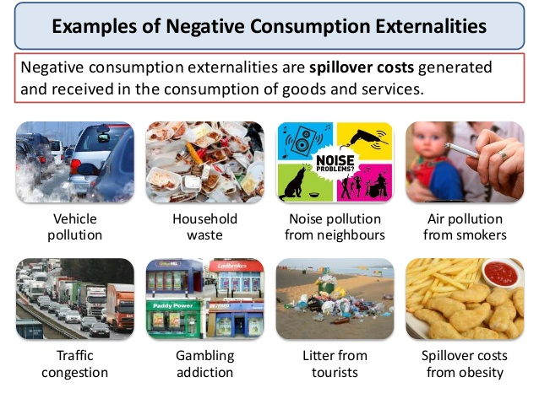
REDUCE
BUY TWO GET ONE FREE!
We ourselves are responsible for the amount of products currently on the market. If we decide to decrease our consumption, we can force producers TO STOP creating so many un-necessary products!
GENERATE NEGATIVE EXTERNAL EFFECTS!

Slide 17
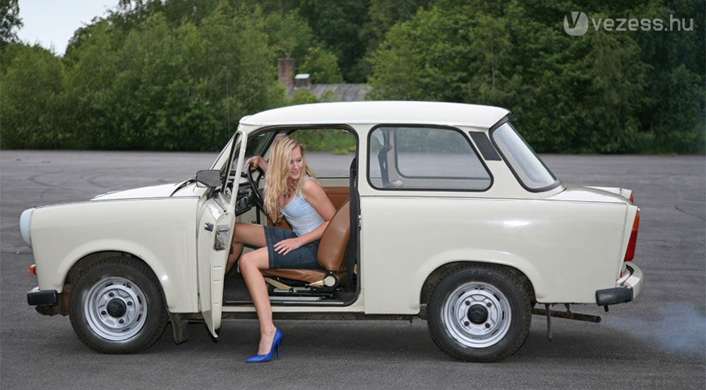

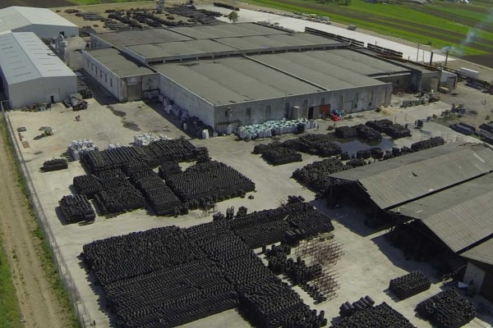
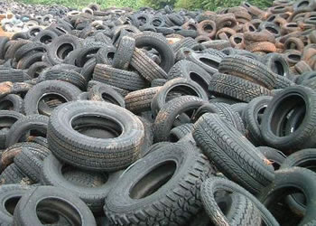

REUSE?
Used car or old car?
High quality ‘English’ used products!
Little help!!
THE FLOOR IS YOURS!
Please!
ret-reading company
ENGLISH USED CLOTHES
WHOLESALE DEALER

Slide 18

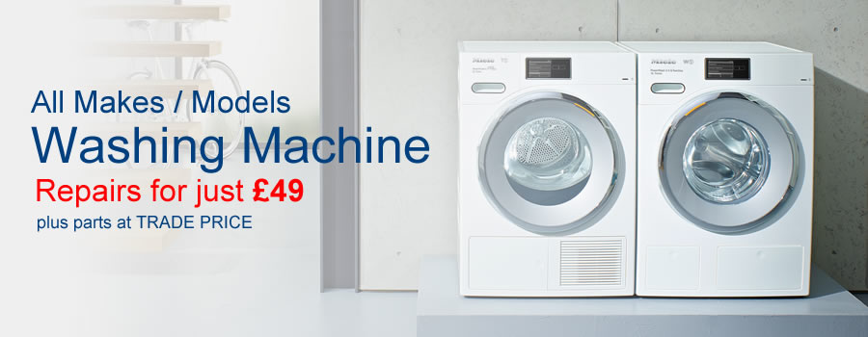
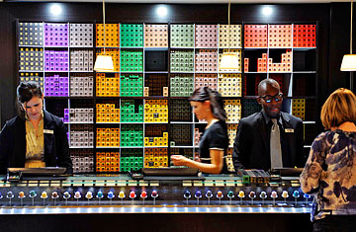
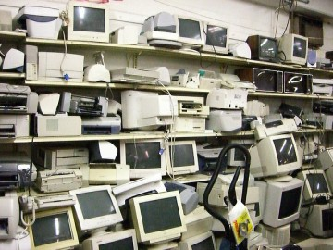
Repair, Refurbish and Remanufacture
…mottos of the XXI. century's consumer society: "I recommend buying new, it is cheaper than the repair costs".
Nespesso service shop (professional lock-in effect)
This is due to us aiming to make a new product from the elements of used products.
Circular planning prefers the creation of products that are easy to disassemble, to make the various elements, parts easy to exchange with new ones.

Slide 19
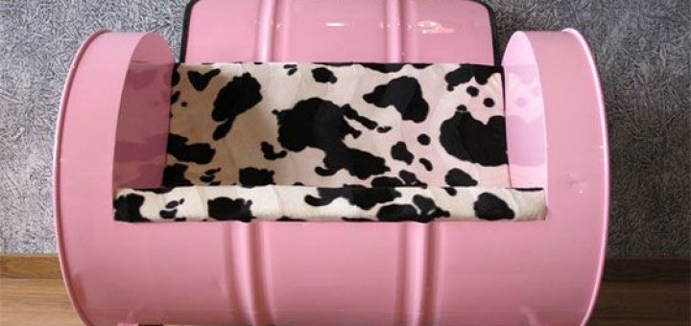
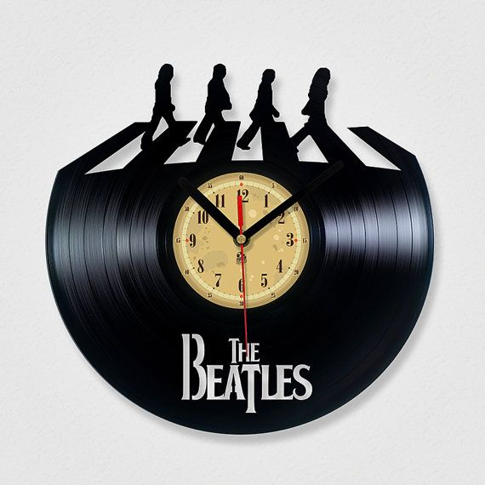
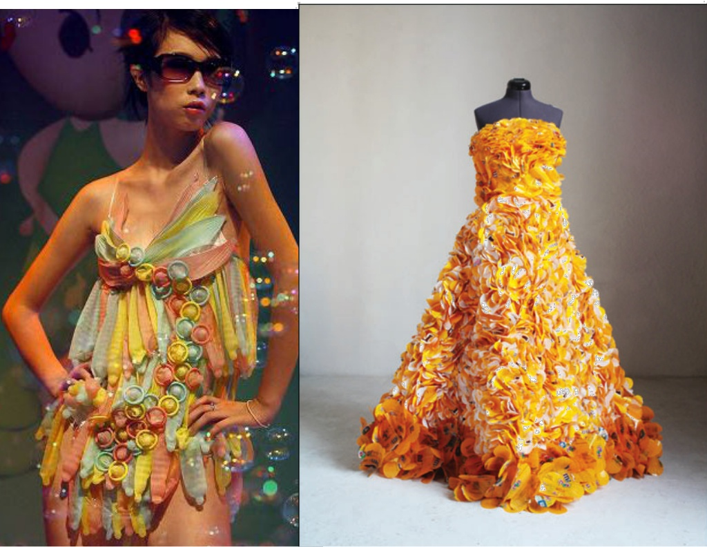
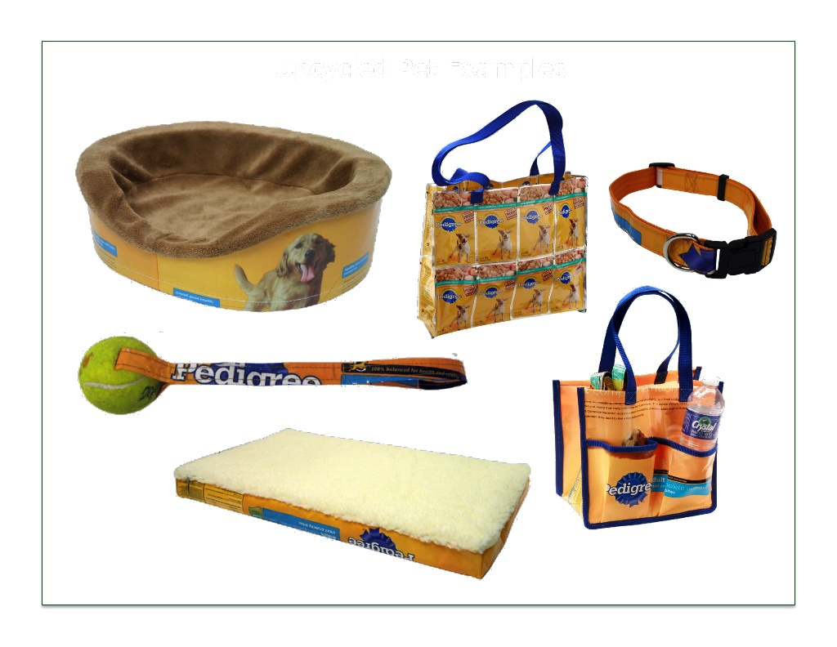
Up-cycling (re-purpose)
This is the first method which shows some similarity with current trends to some extent. This is caused due to the so-called 'retro' perspective being a fad all around the year, which supports the various methods of reusing already used products.

Slide 20
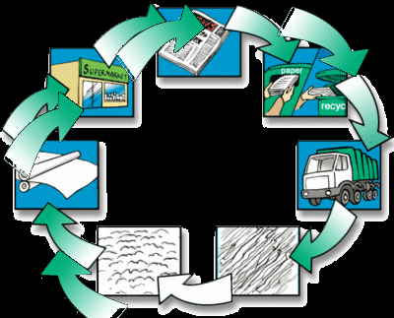
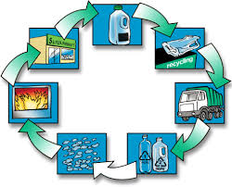
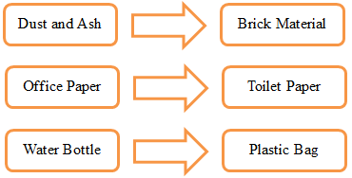
RECYCLE OR DOWNCYCLE
Regarding the concept of circular economies, this mechanism is the first to come up in people's minds. However, our “Dear Reader surely understood by now”, that the idea based on circulation is no more than simply returning material into the process.
During recycling, circularity policies are only implemented in a faded manner, since we cannot speak of sustaining the product function, or creating a new function.
Nowadays the materials used to manufacture products are extremely complex . This is one of the reasons for the product returning facilities not working sufficiently even in countries like the Netherlands!
glass
paper

Slide 21
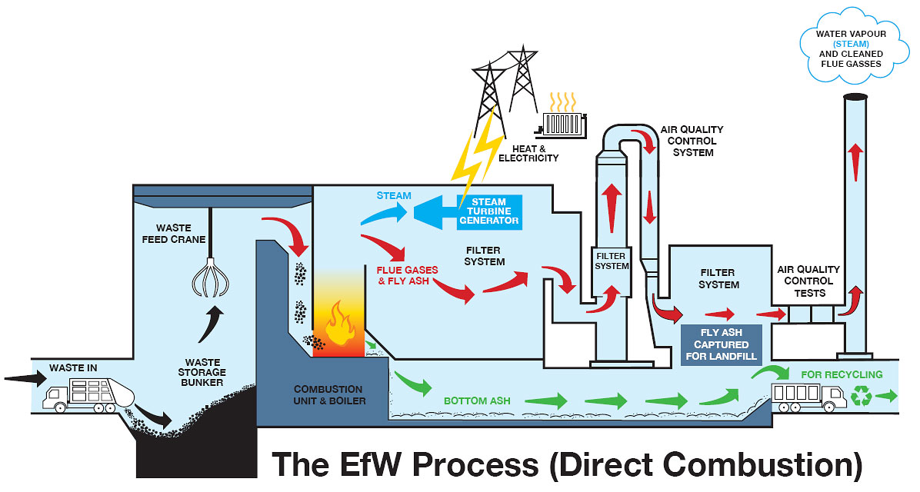
REcovery
Only energy recovery – we lose the material!!
Recovering energy from waste is basically one of the most primitive methods of waste treatment processes. People usually associate to energy produced in trash combustors when thinking about this method, which may have a significantly different efficiency due to differences in the actual facility

Slide 22

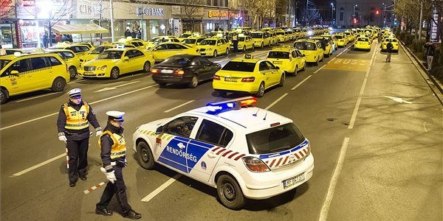
Circular ‘experiences’ in different European countries
Reuse network by HÁDA
Import products - used car tyre depo and ret-reading company somewhere in Romania
Sharing economy vs. Uber
The used products which would not be sold in western countries are better to be exported to regions where they meet the demand standards. The problem takes place at the cases when the results of overconsumption end up in second hand stores of other nations without any usage. Therefore we suggest to extend national boundaries to reach higher levels of circularity on EU level, but the appropriate legislation is required to avoid linear processes.

Slide 23

SOLAR POWER SYSTEMS „ZERO WASTE” PLANNING
COST OF NEW SOLAR PANEL REDUCEABLE WITH 30% IF WE REUSING

Slide 24
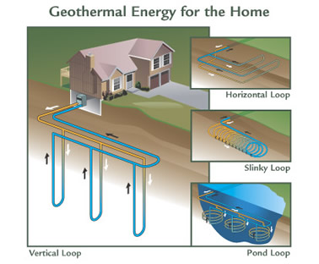
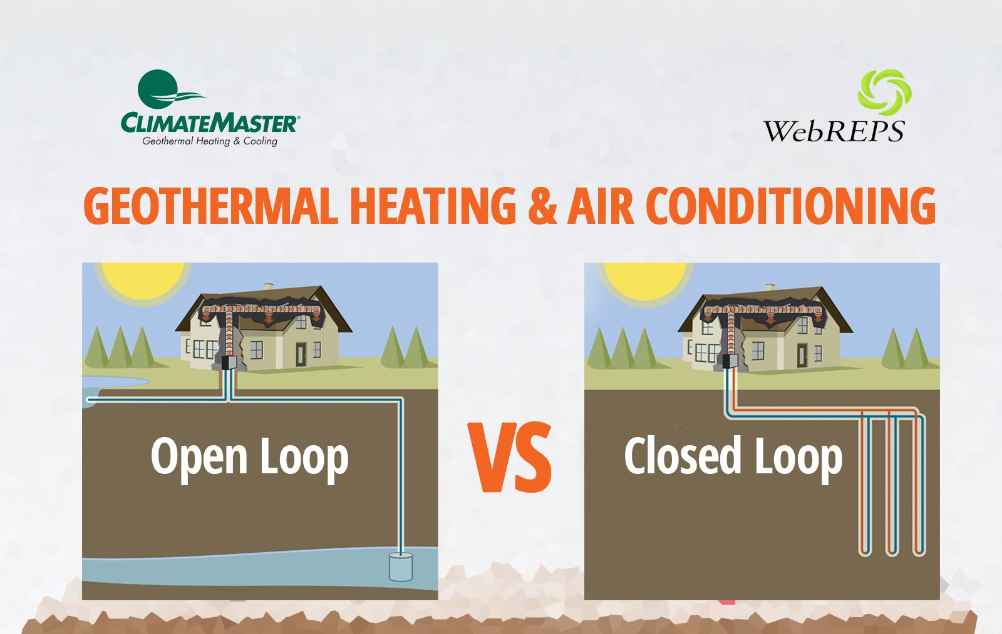
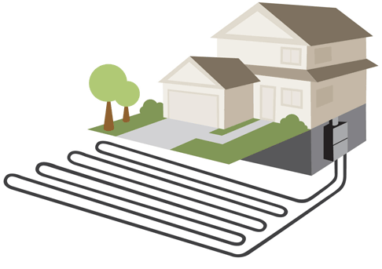
Closed GEOTHERMAL SYSTEMS

Slide 25
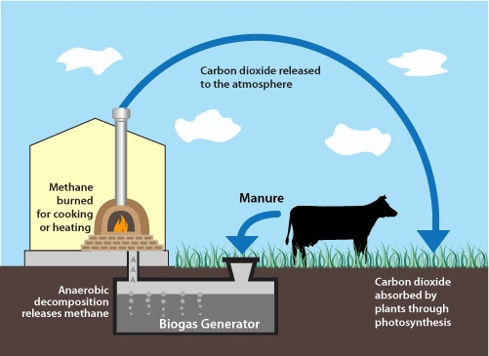
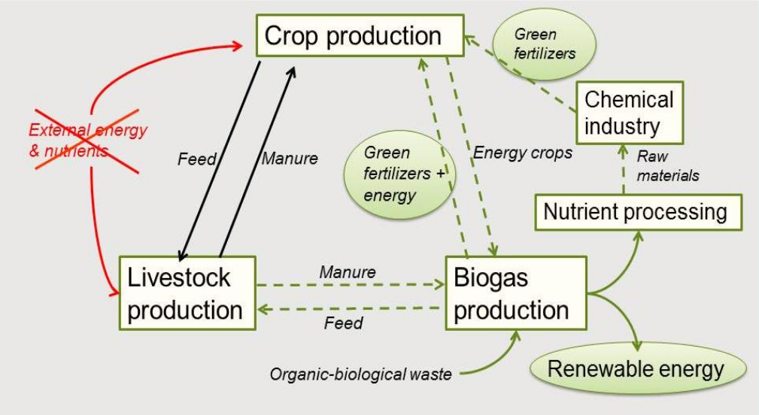
Circular biogas system

Slide 26
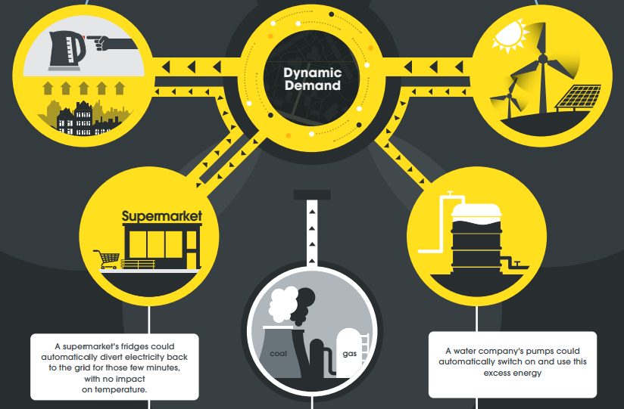



Rescoop and smart systems
„What we need in the first place is not technology, we need NEW BUSINESS MODELS that operate like ecosystems. If we cannot design business models that offer what is good for you & Nature cheaper than junk: forget sustainability!”
Italy was the PIONEER OF USING SMART measurement systems at the end of the 1990's!
Smart metering from the past century (time-of-use metering)
Renewable Energy Source Cooperative (RESCOOP)

Slide 27

THANK YOU FOR YOUR ATTENTION!
CSABA@FOGARASSY.HU

Slide 28


acknowledgement
The presentation was supported by the HU03-0005-C1-2014 project which is part of the EEA Grants 2009-2014 Renewable Energy programme area.
Links: www.eeagrants.org; www.egt-newenergy.szie.hu

